Slide 1
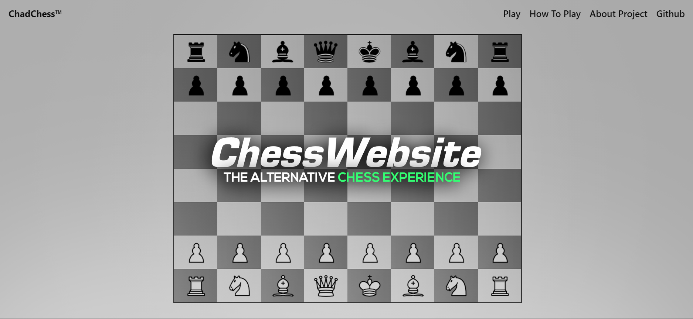

Slide 2
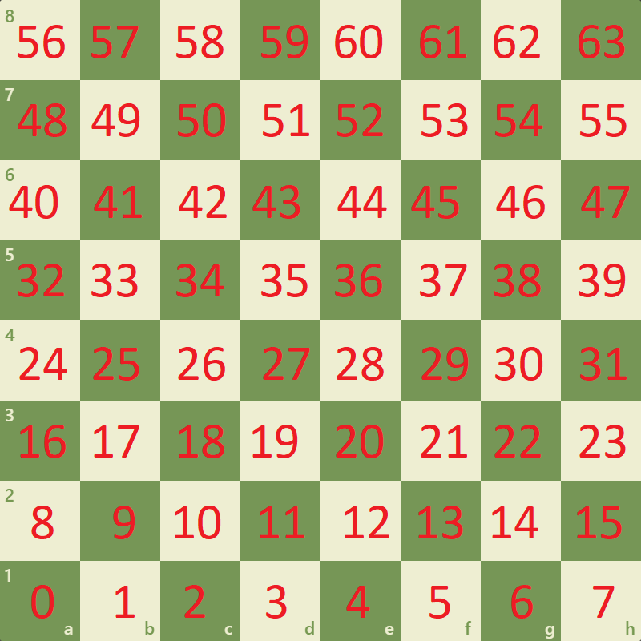
Bitboards
Unsigned long longs
Bit Operations increase efficiency versus string comparisons
Need Several Bitboards i.e. All Pieces, White Pieces, Black Pawns etc.
Ki_mvs = KLT[square] ^ (pieces[color] & KLT[square]);

Slide 3
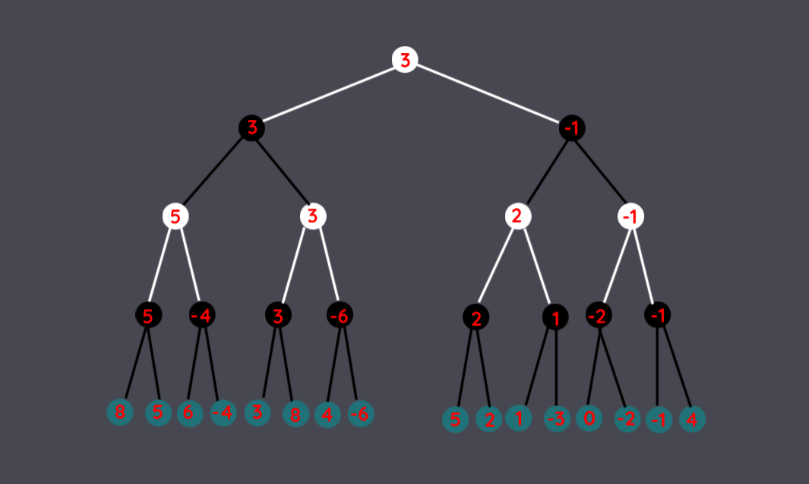
Minimax Search Algorithm

Slide 4
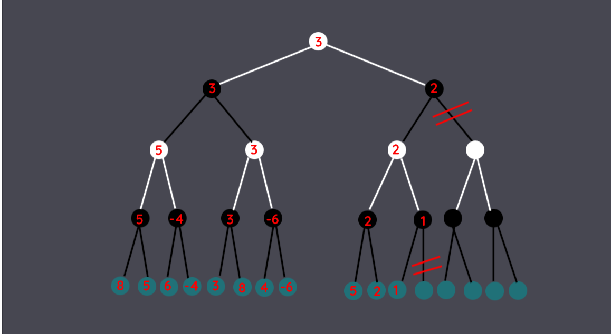
With Alpha-Beta Pruning

Slide 5
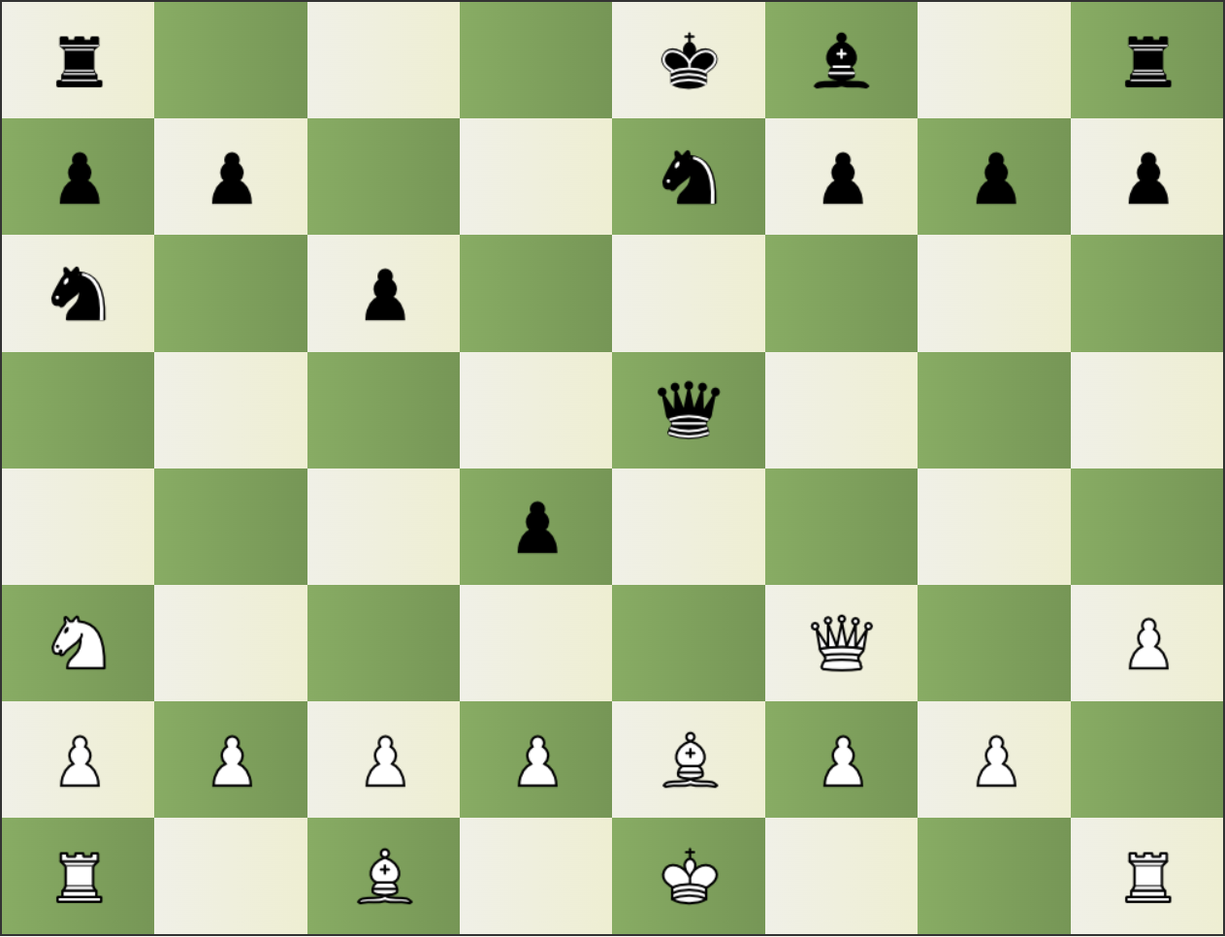
Evaluation
Engine scores each position based on certain characteristics:
Material Imbalance
King Safety
Piece Development
This score is used in the Minimax search algorithm to find the best position.

Slide 6

WebAssembly
Works as a C++ compiler.
Instead of an executable it generates a .js and .wasm file.
Can then use any functions or classes you binded by using the .js file generated.
Hi mom

Slide 7
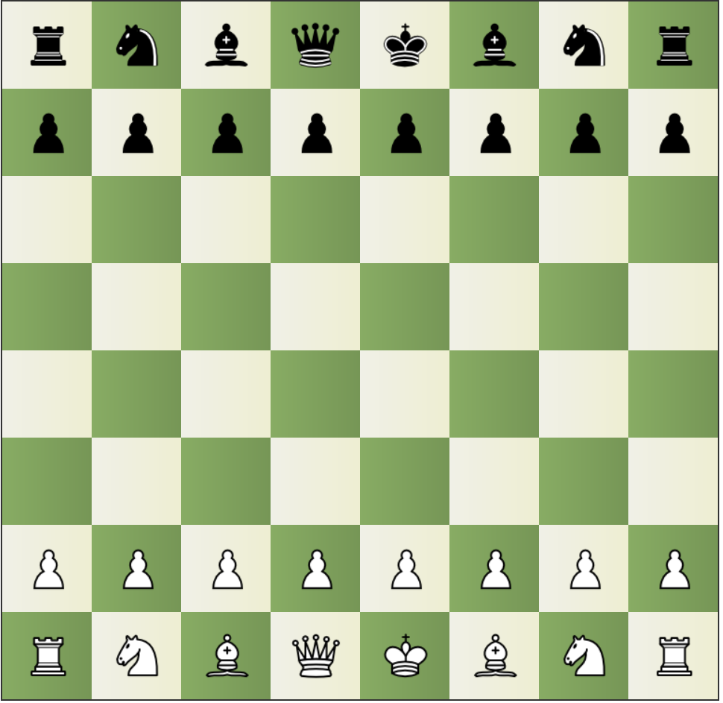
Fenstrings
rnbqkbnr/pppppppp/8/8/8/8/PPPPPPPP/RNBQKBNR w KQkq - 0 1

Slide 8
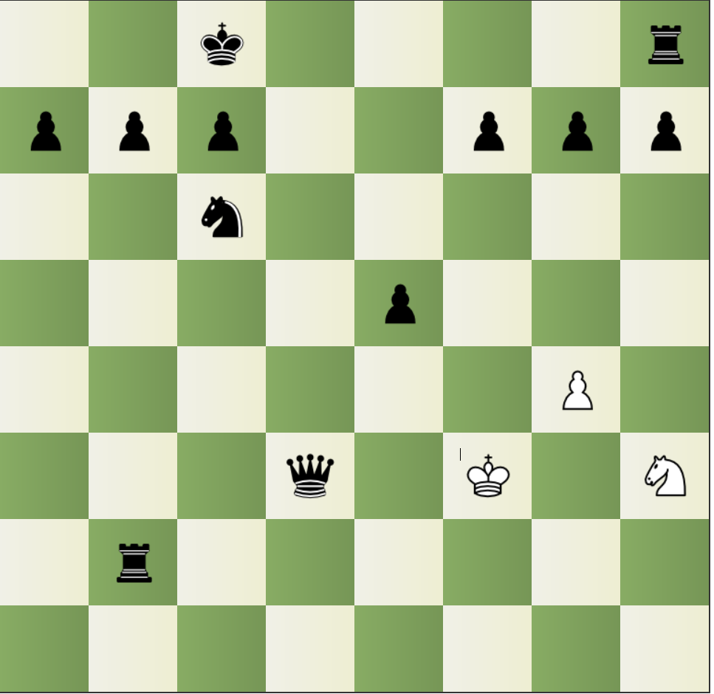
Fenstrings 2
2k4r/ppp2ppp/2n5/4p3/6P1/3q1K1N/1r6/8 w - - 0 23

Slide 9



The Web Application
Svelte (front-end framework used)
TailwindCSS (majority of styling)
HTML, CSS, JavaScript (used on chess board)
Take a look: http://localhost:5173

Slide 10
Citations for Images Used in Presentation
https://github.com/sveltejs/branding
https://en.wikipedia.org/wiki/WebAssembly
https://tailwindcss.com/
https://www.freepnglogos.com/images/html5-logo-31816.html

